Slide 1
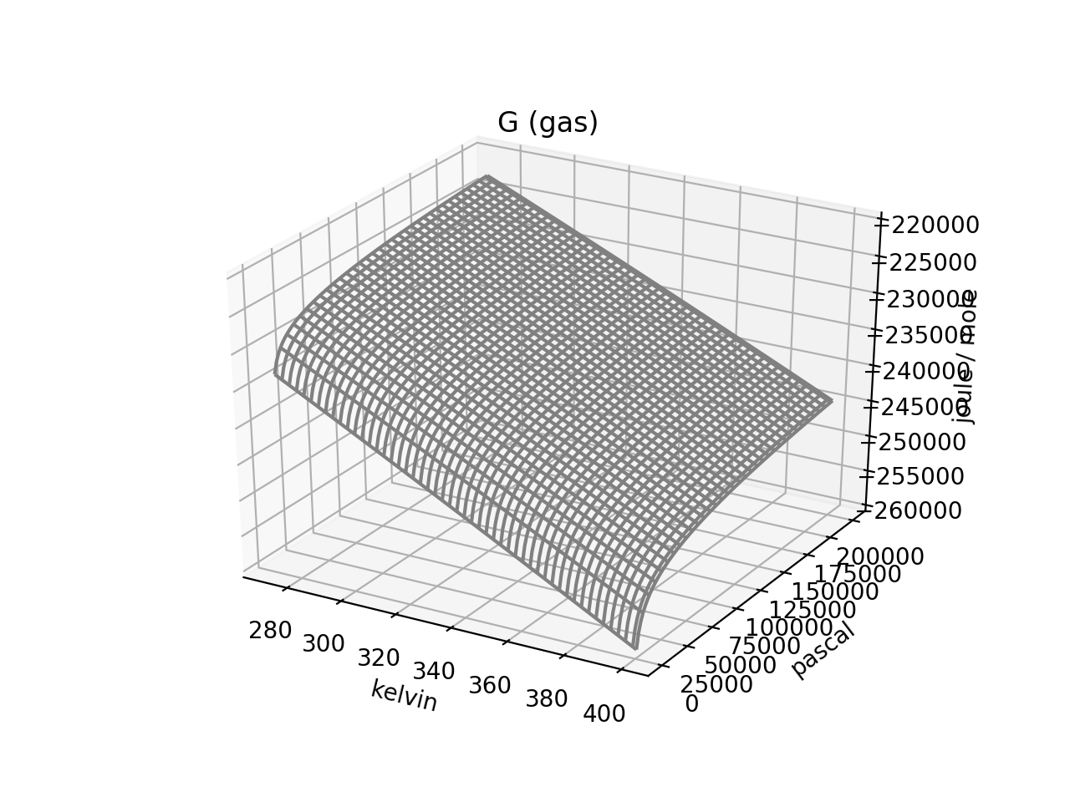
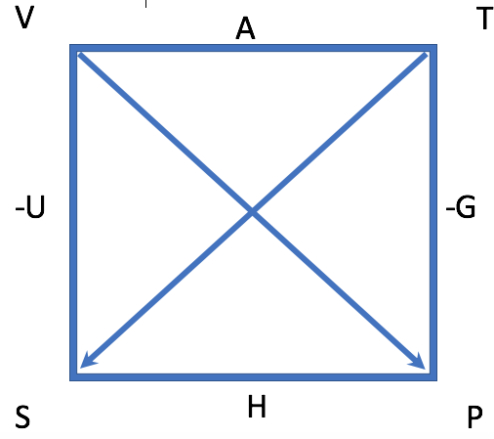
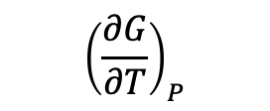

Here’s a depiction of $G(T,P)$
$${\left(\frac{∂G}{∂T}\right)}_{P}$$
$${\left(\frac{∂G}{∂P}\right)}_{T}$$
Pressure
Temperature

Slide 2
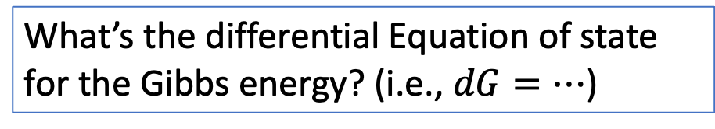
The kind of question I might ask – The differential equation of state for $G(T,P)$
What’s the differential Equation of state for the Gibbs energy? (i.e., $dG=…$)
$${\left(\frac{∂G}{∂T}\right)}_{P}$$
$${\left(\frac{∂G}{∂P}\right)}_{T}$$
Pressure
Temperature

Slide 3

The kind of question I might ask – The differential equation of state for $G(T,P)$
What’s the differential Equation of state for the Gibbs energy? (i.e., $dG=…$)
$${\left(\frac{∂G}{∂T}\right)}_{P}$$
$${\left(\frac{∂G}{∂P}\right)}_{T}$$
Pressure
Temperature
$dG=−SdT+VdP$

Slide 4
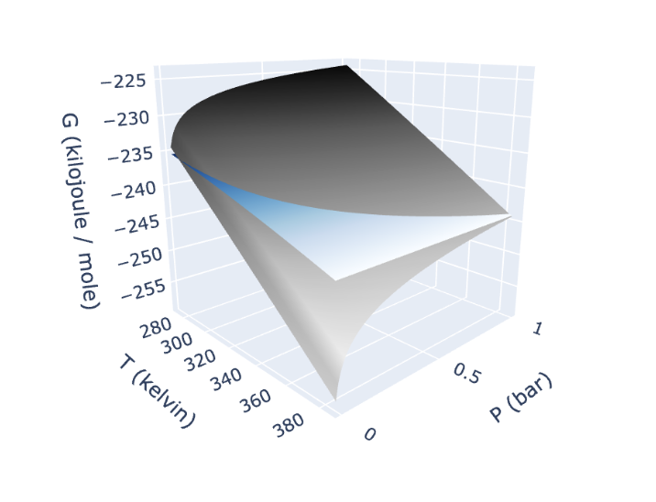
The kind of question I might ask – Distinguishing between Gibbs energy of phases $)$
Which of these is the liquid, and which is the gas?
$dG=−SdT+VdP$

Slide 5
The kind of question I might ask – Distinguishing between Gibbs energy of phases
Which of these is the liquid, and which is the gas?
Liquid
Gas
$dG=−SdT+VdP$

Slide 6
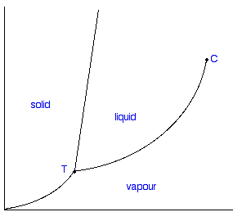
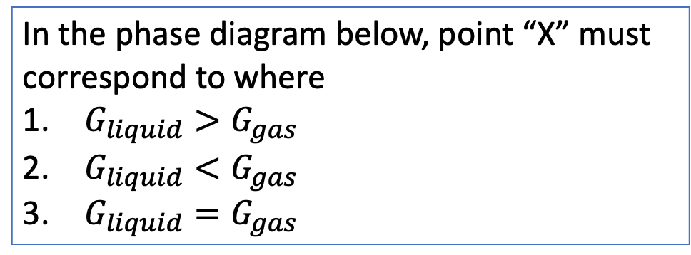
Weeks 12/13 – Intersecting $G(T,P)$ thermodynamic surfaces
In the phase diagram below, point “X” must correspond to where
$G_{liquid}>G_{gas}$
$G_{liquid}<G_{gas}$
$G_{liquid}=G_{gas}$
Liquid
Gas
P
$dG=−SdT+VdP$
X
T

Slide 7
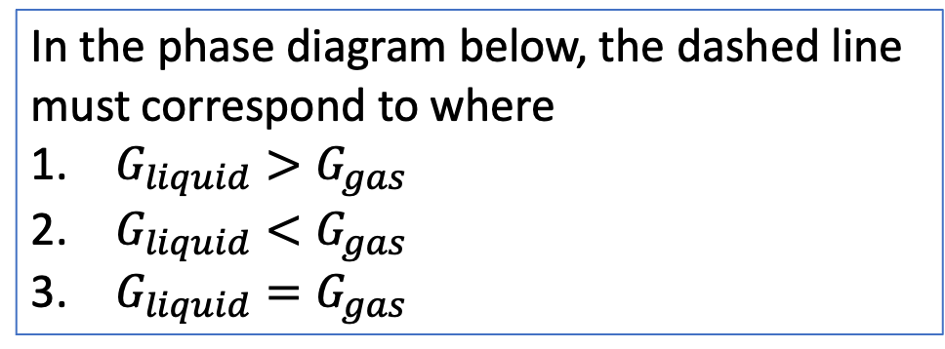
Weeks 12/13 – Intersecting $G(T,P)$ thermodynamic surfaces
In the phase diagram below, the dashed line must correspond to where
$G_{liquid}>G_{gas}$
$G_{liquid}<G_{gas}$
$G_{liquid}=G_{gas}$
Liquid
Gas
P
$dG=−SdT+VdP$
X
T

Slide 8
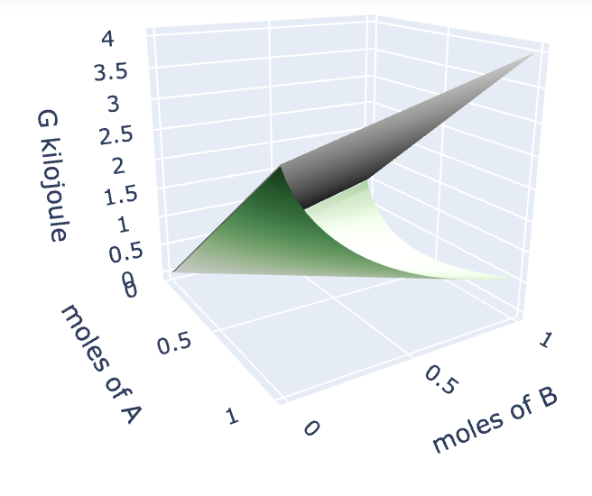
Weeks 12/13 – Gibbs energy in composition state space ($n_{A}$ and $n_{B}$)

Slide 9
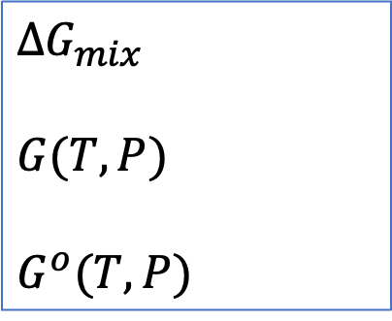
The kind of question I might ask – Distinguishing between $∆G_{mix}$, $G\left(T,P\right)$, and $G^{o}(T,P)$
#1
$∆G_{mix}$
$G(T,P)$
$G^{o}(T,P)$
#2
#3

Slide 10
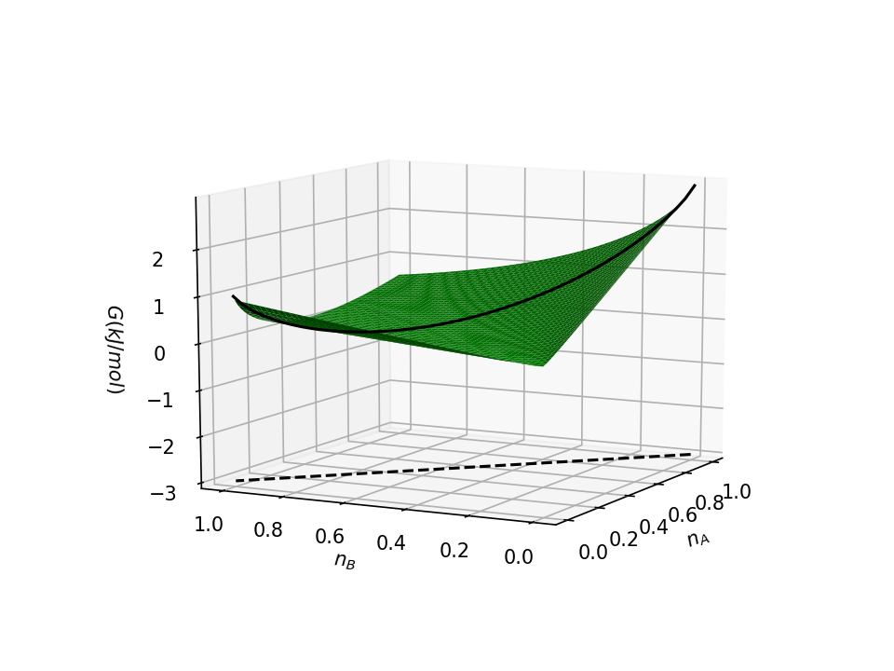
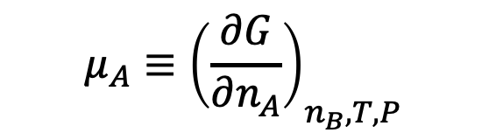
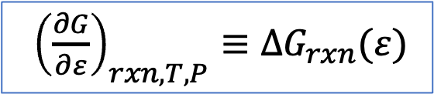
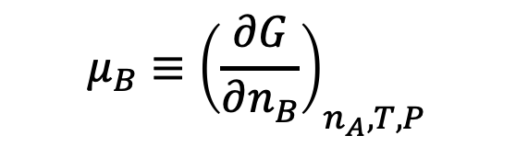
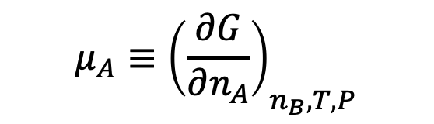
Weeks 12/13 – Chemical potentials are slopes in $n_{A}$, $n_{B}$ state space
$$μ_{A}≡{\left(\frac{∂G}{∂n_{A}}\right)}_{n_{B}, T,P}$$
$$μ_{B}≡{\left(\frac{∂G}{∂n_{B}}\right)}_{n_{A}, T,P}$$
$$μ_{A}≡{\left(\frac{∂G}{∂n_{A}}\right)}_{n_{B}, T,P}$$
${\left(\frac{∂G}{∂ε}\right)}_{rxn,T,P}≡∆G_{rxn}(ε)$

Slide 11
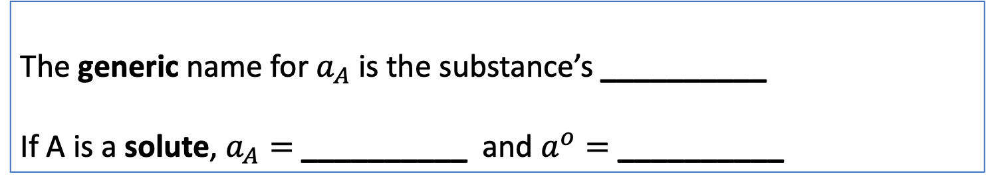
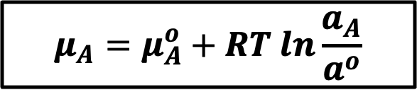
The kind of question I might ask – Meaning of terms in the chemical potential expression
$$μ_{A}=μ_{A}^{o}+RT ln\frac{a_{A}}{a^{o}}$$
The generic name for $a_{A}$ is the substance’s __________
If A is a solute, $a_{A}=$ __________ and $a^{o}=$ __________

Slide 12
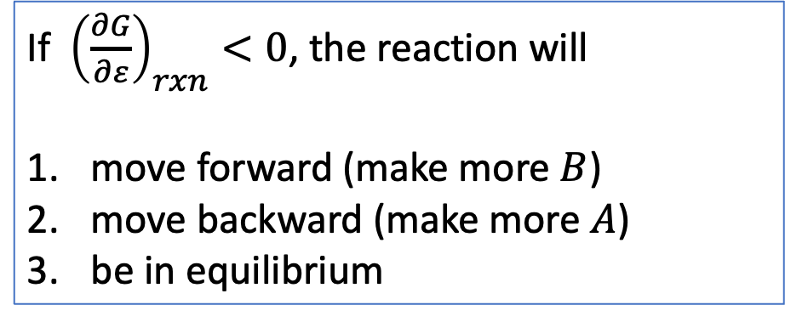

The kind of question I might ask – Slope of the Gibbs energy in the reaction direction
If ${\left(\frac{∂G}{∂ε}\right)}_{rxn}<0$, the reaction will
move forward (make more $B$)
move backward (make more $A$)
be in equilibrium
$$ε$$

Slide 13
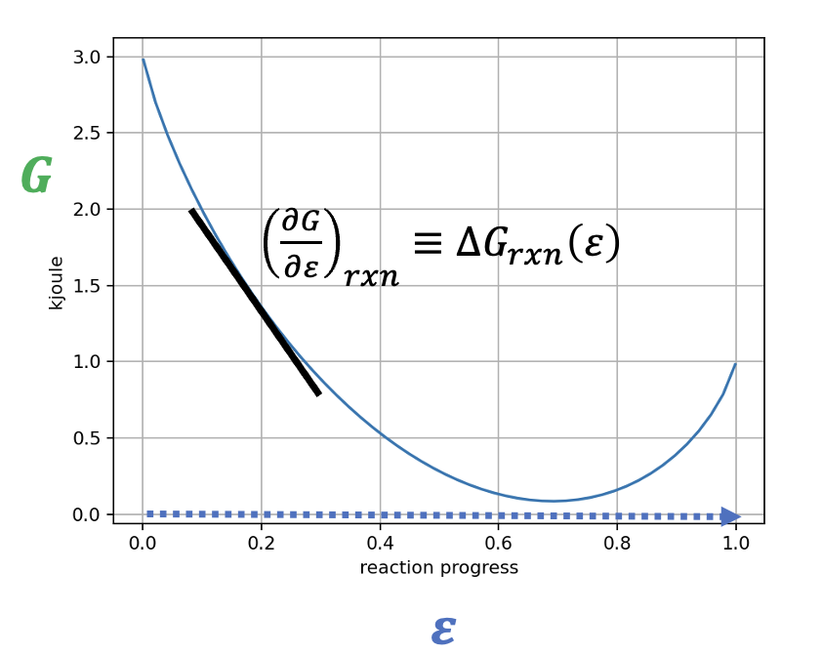
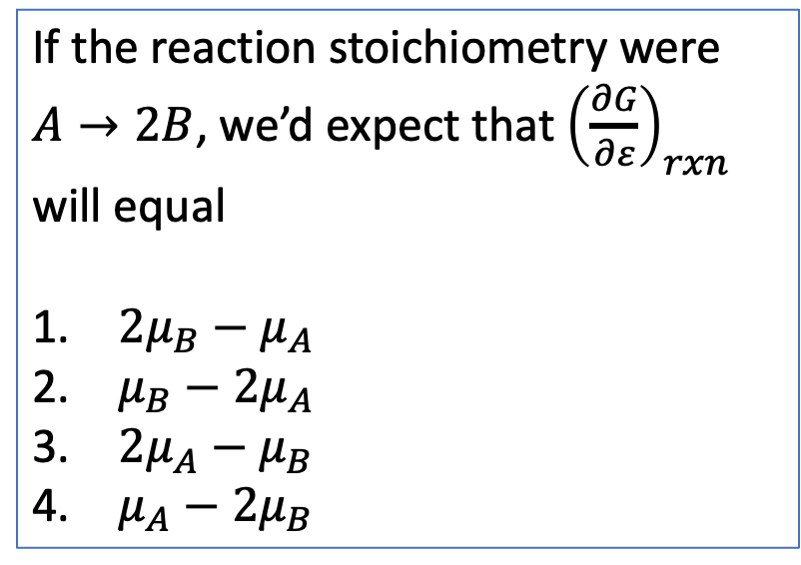
The kind of question I might ask – How ${\left(\frac{∂G}{∂ε}\right)}_{rxn}$relates to chemical potentials
If the reaction stoichiometry were $A→2B$, we’d expect that ${\left(\frac{∂G}{∂ε}\right)}_{rxn}$ will equal
${2μ}_{B}−μ_{A}$
$μ_{B}−{2μ}_{A}$
$2μ_{A}−μ_{B}$
$μ_{A}−{2μ}_{B}$

Slide 14
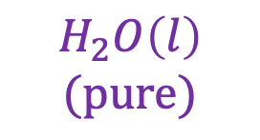
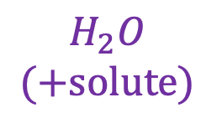
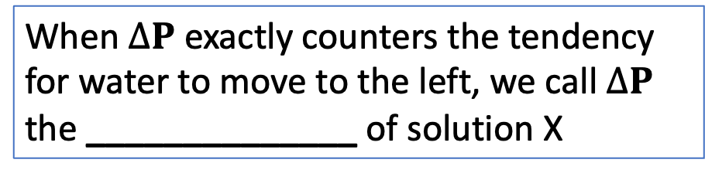

The kind of question I might ask – About osmosis
Chamber X is a 1 M solution of NaCl(aq)
Chamber Y is pure water.
$$∆P$$
When $∆P$ exactly counters the tendency for water to move to the left, we call $∆P$ the ______________ of solution X
Y
X
$$H_{2}O$$
$$(+solute)$$
$$H_{2}O\left(l\right)$$
$$(pure)$$

Slide 15

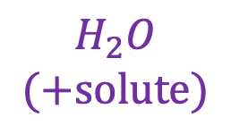
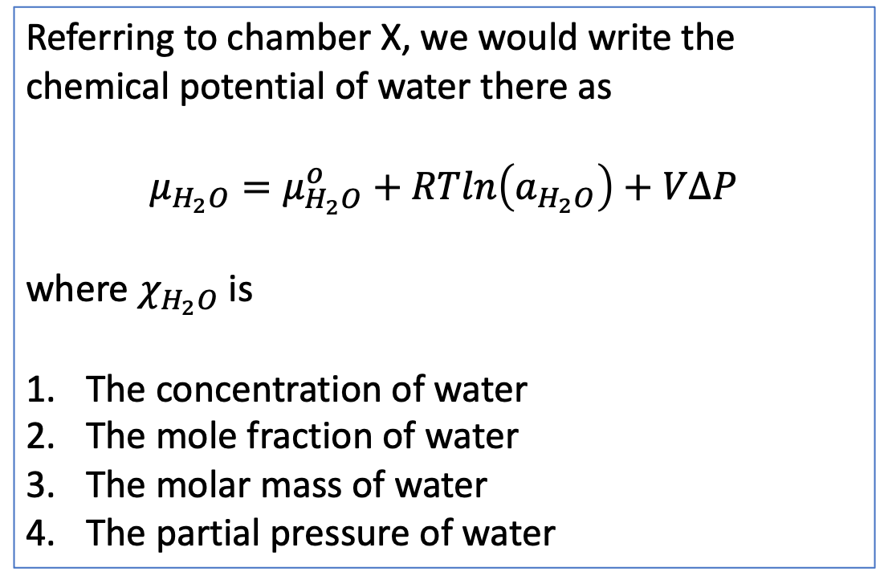

The kind of question I might ask – About osmosis
Chamber X is a 1 M solution of NaCl(aq)
Chamber Y is pure water.
Referring to chamber X, we would write the chemical potential of water there as
$$μ_{H_{2}O}=μ_{H_{2}O}^{o}+RTln\left(a_{H_{2}O}\right)+V∆P$$
where $χ_{H_{2}O}$ is
The concentration of water
The mole fraction of water
The molar mass of water
The partial pressure of water
$$∆P$$
Y
X
$$H_{2}O$$
$$(+solute)$$
$$H_{2}O\left(l\right)$$
$$(pure)$$

Slide 16
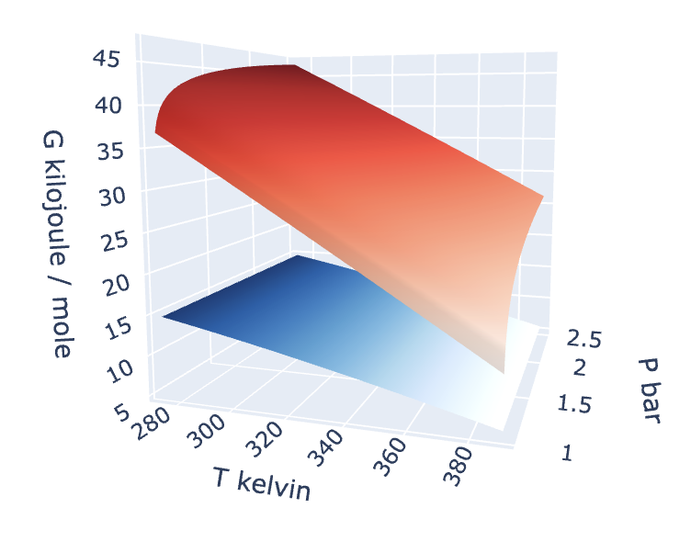
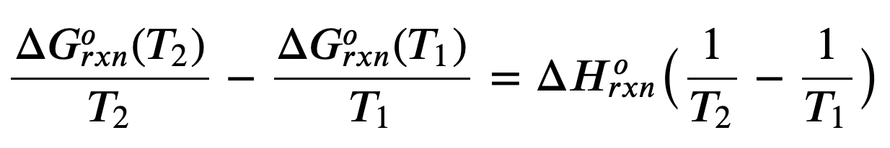
The kind of question I might ask – Name of an equation
The equation below allows us to make a prediction about the Gibbs energy of reaction at a new temperature:
$$T_{1}$$
$$T_{2}$$
What’s the name of this equation?
What assumption is needed to make in using it?

